Slide 1
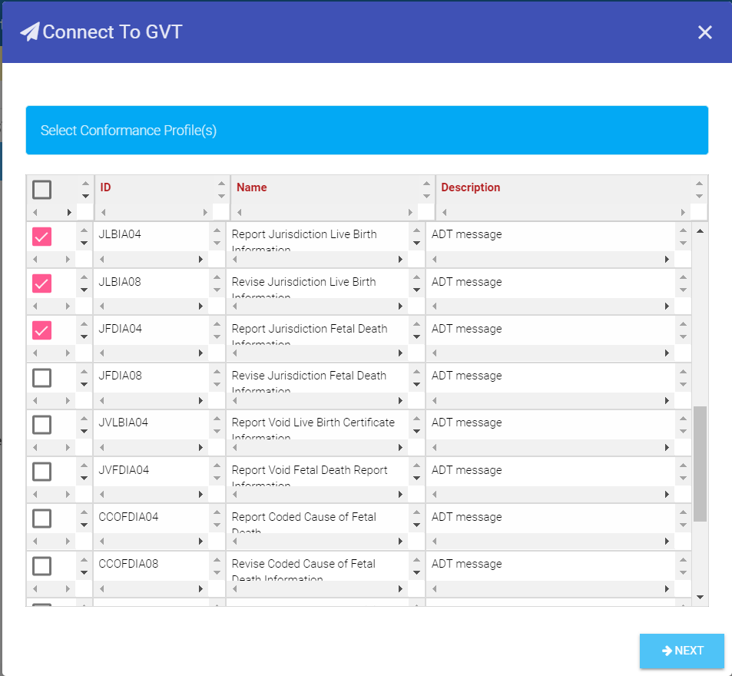
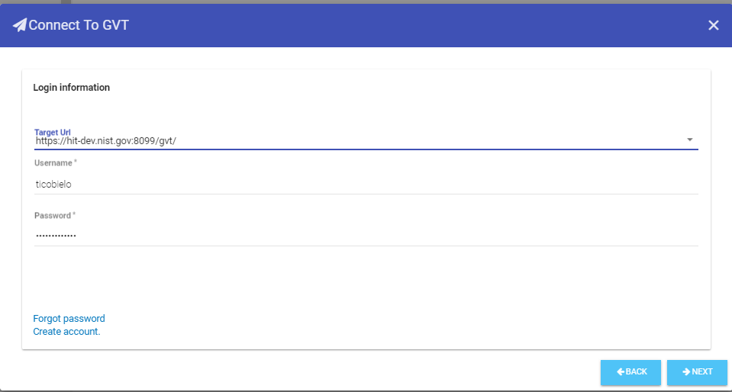
Connecting and Pushing Profiles to GVT from IGAMT (1)
1
In IGAMT, select IG Documents from the main Menu Bar; open an IG document, select Connect from the IG Document Menu Bar, and select Conformance Profile, or Composite Profile if available, from the dropdown menu.
2
4
From the Connect to GVT window, select desired conformance profiles from the Select Conformance Profile(s) list.
Select GVT URL, enter Username and Password for GVT, and click NEXT to connect to GVT.
3
Click on NEXT.
See next slide

Slide 2
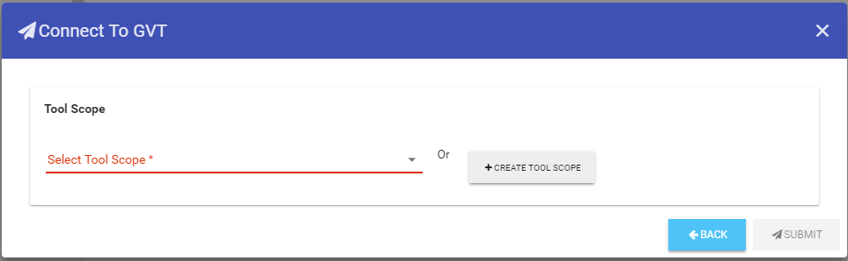
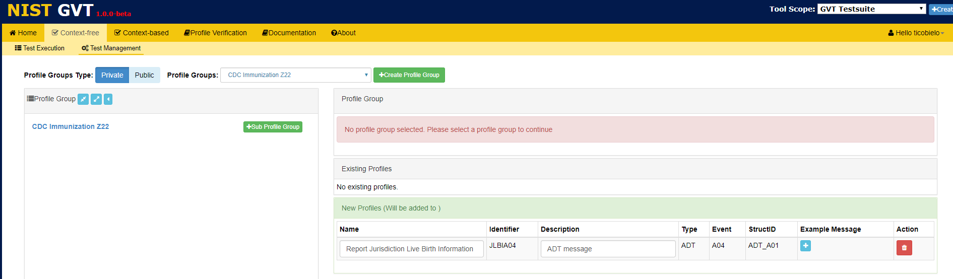
Connecting and Pushing Profiles to GVT from IGAMT (2)
5
Select a Tool Scope and SUBMIT OR
click on +CREATE TOOL SCOPE and SUBMIT.
6
In GVT Test Management, click on the Profile Group name to continue.
See next slide

Slide 3
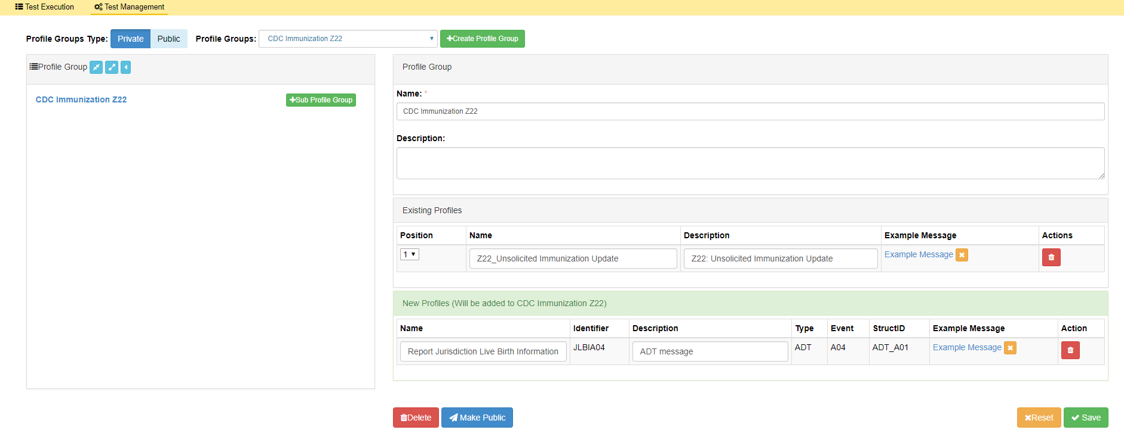
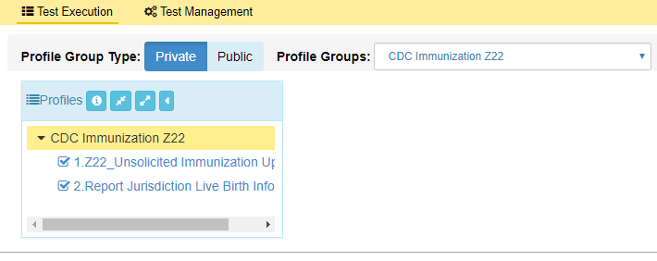
Connecting and Pushing Profiles to GVT from IGAMT (3)
7
View Profile Group information.
8
Enter (type in or copy/paste) Example Message and click √Save.
Profile Group Type is Private by default; click on Make Public to change to Public type.
9
View Profile Group in the Profiles list panel in GVT Test Execution.

